Slide 1

MODULE 3: PROGRAMMING FOR BIOLOGICAL DATA
Session 6: ANOVA and Linear Regression
Comparing Multiple Groups & Building Calibration Curves
Instructor: Dr. Haogao Gu | Date: January 21, 2026
Updated on January 21

Slide 2







Learning Objectives
ANOVA
Post-hoc
Regression
Validation
Compare means across multiple groups using Analysis of Variance.
Identify exactly which groups differ using Tukey HSD.
Build linear regression models for standard calibration curves.
Assess model fit using R² and rigorous residual analysis.

Slide 3


Clinical Context
Method Applications
Today's Scenarios
Method | Application
ANOVA | Compare 3+ analyzers, reagent lots, or operators.
Regression | Build calibration curves and verify assay linearity.
•
Scenario 1: Are our three chemistry analyzers giving consistent results?
•
Scenario 2: Is our assay linear across the reportable range according to CLSI EP06?

Slide 4

Part 1: Analysis of Variance (ANOVA)
Comparing Means Across Multiple Groups

Slide 5
When to Use ANOVA
⚠️ Warning
The Right Test for the Job
Running multiple t-tests inflates the false positive rate!
Scenario | Statistical Test
Compare 2 groups | T-test
Compare 3+ groups | ANOVA
•
Comparing 3 groups requires 3 separate t-tests.
•
This leads to a ~14% chance of finding a false difference.
•
ANOVA controls this error by testing all at once.

Slide 6


Scenario: Analyzer Comparison
The Setup
Preliminary Data
Your lab has three chemistry analyzers: A, B, and C.
Analyzer | Mean Glucose | SD
A | 102.3 | 1.4
B | 96.9 | 2.1
C | 106.1 | 1.6
You run the same glucose QC material 10 times on each instrument.
Question: Are all three analyzers calibrated correctly?

Slide 7
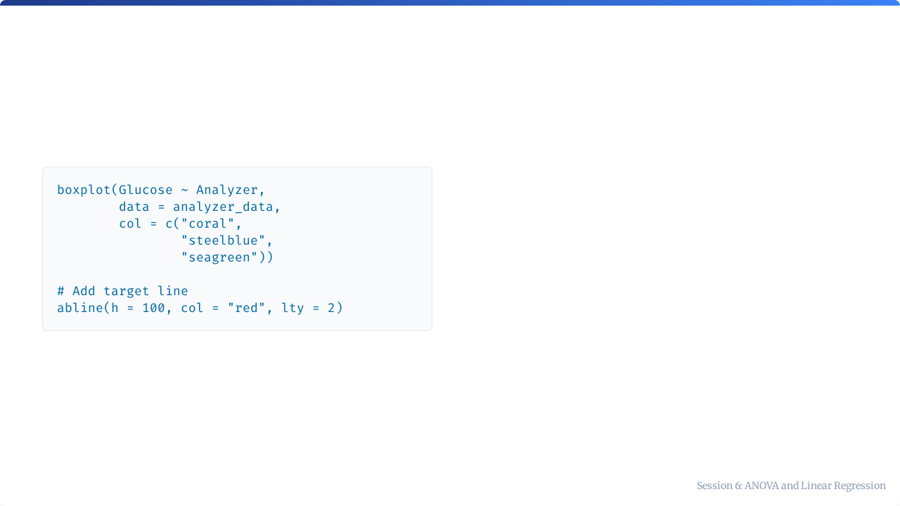
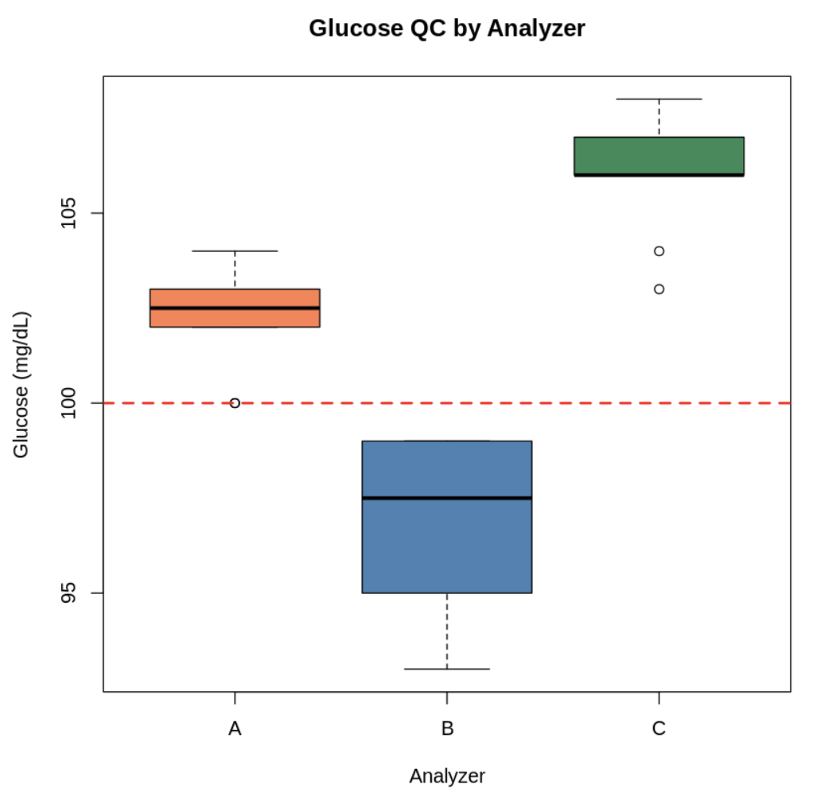

Visualizing with Boxplots
Visual inspection: The boxplot clearly suggests that the analyzers are producing different results, with C being notably higher.

Slide 8



How ANOVA Works
The F-Statistic
ANOVA compares between-group variance (differences between analyzers) to within-group variance (precision error).
Large F = Groups are different Small F = Groups are similar

Slide 9


ANOVA Hypotheses
Alternative Hypothesis (H₁)
Null Hypothesis (H₀)
At least one mean differs from the others.
All group means are equal.
Decision Rule: If p < 0.05, we reject H₀.

Slide 10
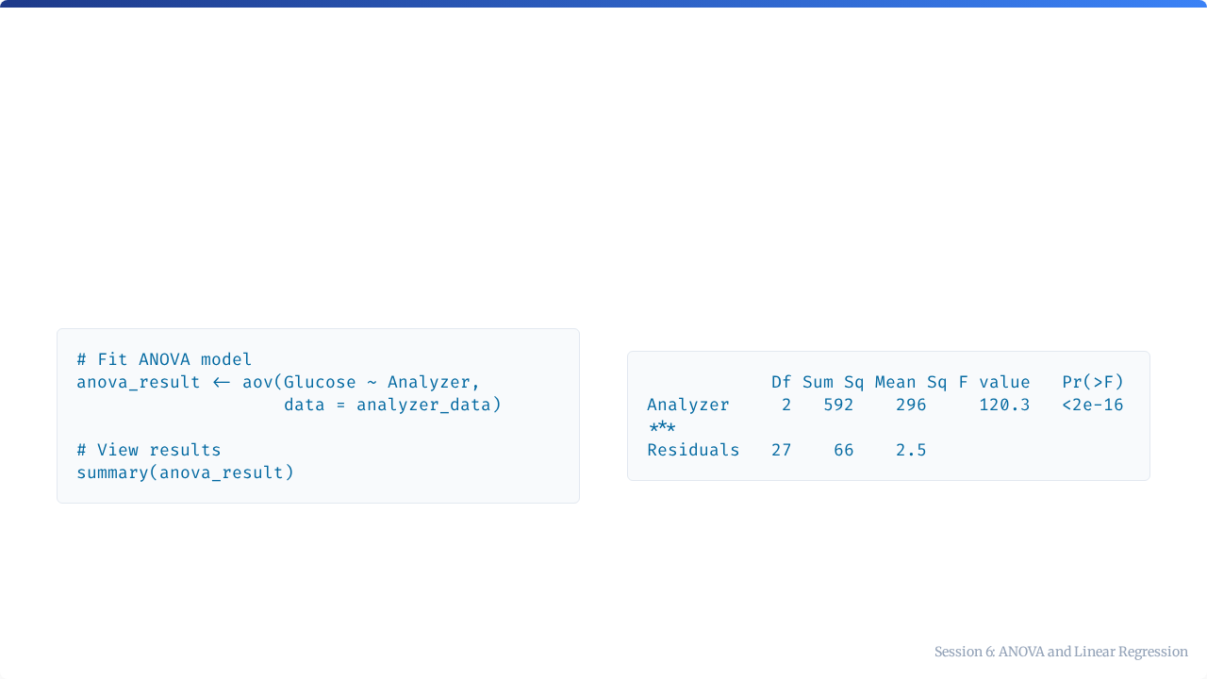
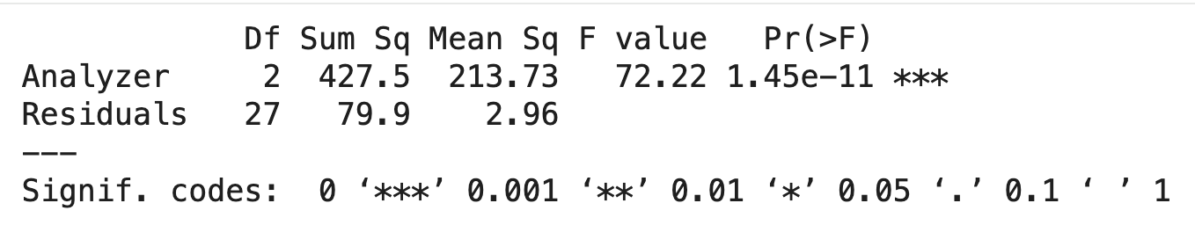
ANOVA in R
R Code
Output

Slide 11
Interpreting the ANOVA Table
Column | Meaning
Df | Degrees of freedom (Groups - 1)
Sum Sq | Sum of squares (total variance explained)
Mean Sq | Mean square = Sum Sq / Df
F value | Test statistic (Variance Ratio)
Pr(>F) | P-value (The probability of this result if H₀ is true)
p < 0.05 → At least one analyzer differs significantly.

Slide 12
The Problem
"ANOVA tells us that 'something' is different, but it doesn't tell us 'what' is different."
To find the specific culprit, we need a post-hoc test.

Slide 13
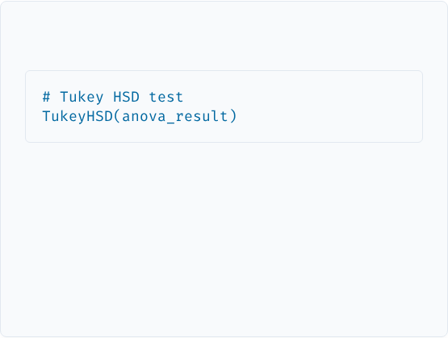

Tukey's Honest Significant Difference
R Code
Purpose
Perform pairwise comparisons after a significant ANOVA to identify exactly which groups differ.
This compares:
It controls for the increased error rate of multiple testing.
•
A vs B
•
A vs C
•
B vs C

Slide 14
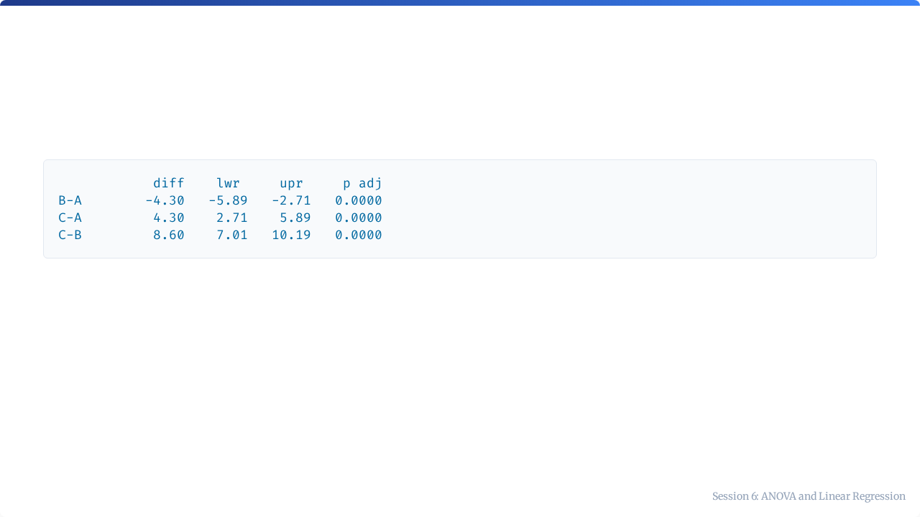
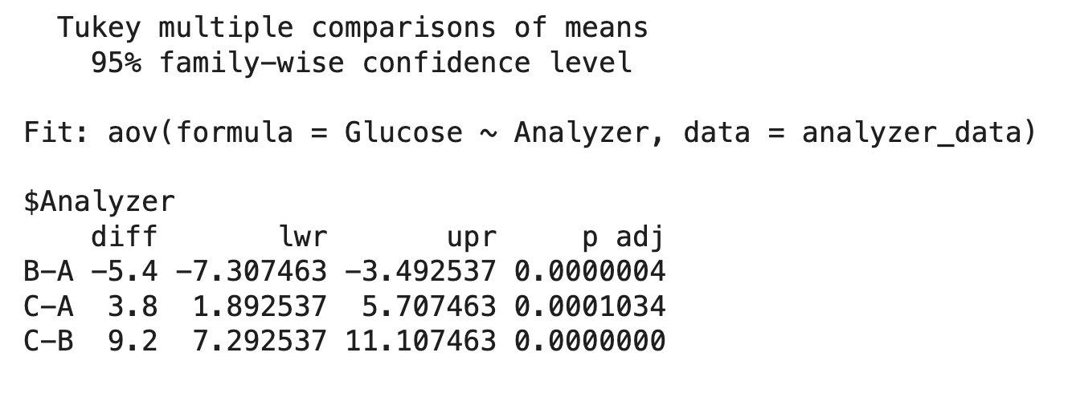
Reading Tukey Output
Column | Meaning
diff | Difference between group means.
lwr, upr | 95% Confidence Interval of the difference.
p adj | Adjusted p-value.

Slide 15
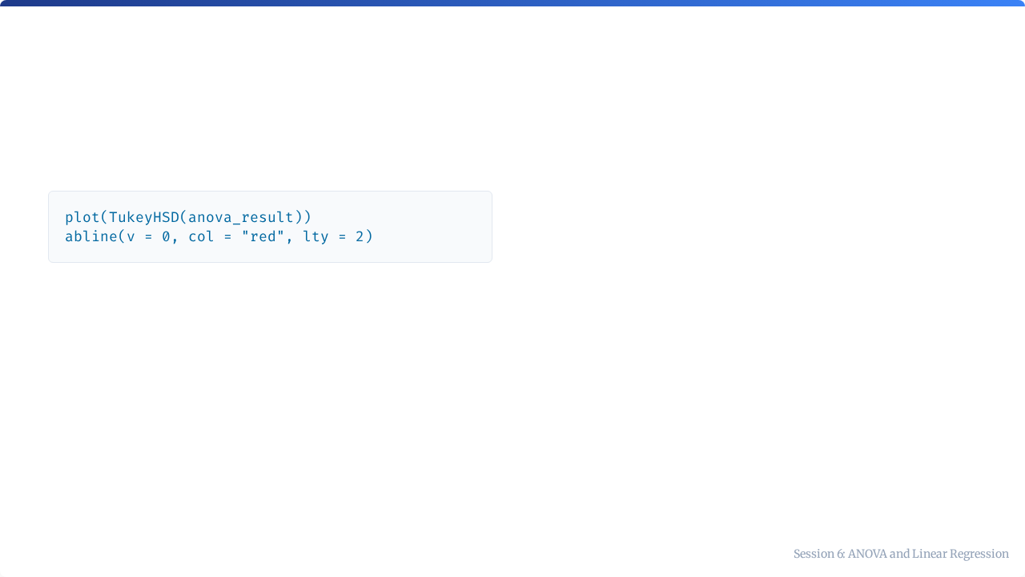
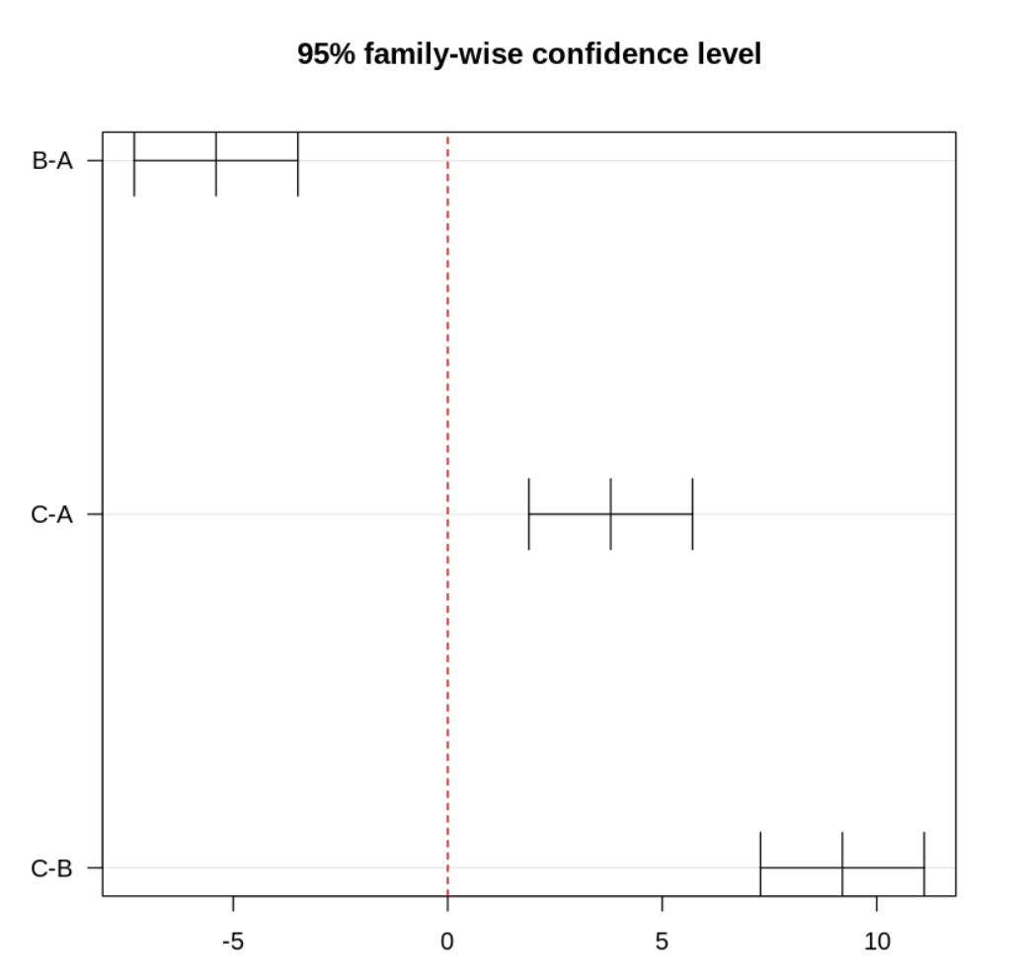
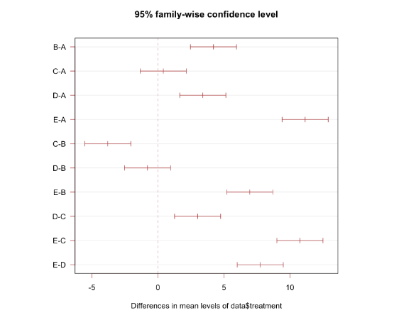
Tukey Plot
Interpretation:
•
The lines represent Confidence Intervals.
•
If an interval crosses zero, the difference is NOT significant.
•
Here, all intervals are far from zero, indicating significant differences for all pairs.

Slide 16
Clinical Action Items
Based on the statistical findings, we take action:
Comparison | Difference | Significant? | Action
B vs A | -7.3 | Yes ⚠️ | Recalibrate B (reading low)
C vs A | +1.9 | Yes ⚠️ | Recalibrate C (reading high)
C vs B | +7.3 | Yes ⚠️ | Major discrepancy detected

Slide 17
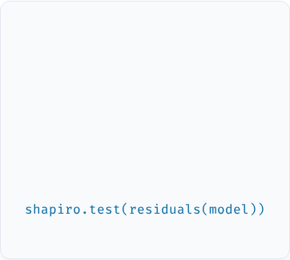
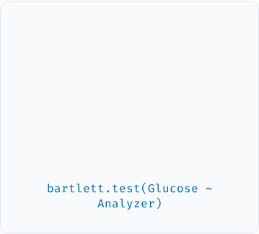

Checking ANOVA Assumptions
1
2
3
Normality
Homogeneity
Independence
Residuals should be normally distributed.
Variances should be equal across groups.
Observations must be independent of each other.

Slide 18
Part 2: Linear Regression & Calibration
Building the Standard Curve

Slide 19

The Foundation of Quantitative Testing
The Concept
Every quantitative assay uses a calibration curve to convert measured signals into concentrations.
Signal = Slope × Concentration + Intercept
We model this relationship using the linear equation.

Slide 20


CLSI EP06: Linearity Verification
Guideline Requirements
Test samples across the full reportable range.
Verify the linear relationship between signal and concentration.
Standard for Lab Compliance
Document recovery at each level.
Identify any saturation or non-linearity.

Slide 21
Linearity Verification Data
Concentration (mg/dL) | Signal (OD) | Replicates
0 (blank) | 0.052 | 3
25 | 0.245 | 3
50 | 0.478 | 3
100 | 0.952 | 3
200 | 1.875 | 3
400 | 3.425 | 3

Slide 22
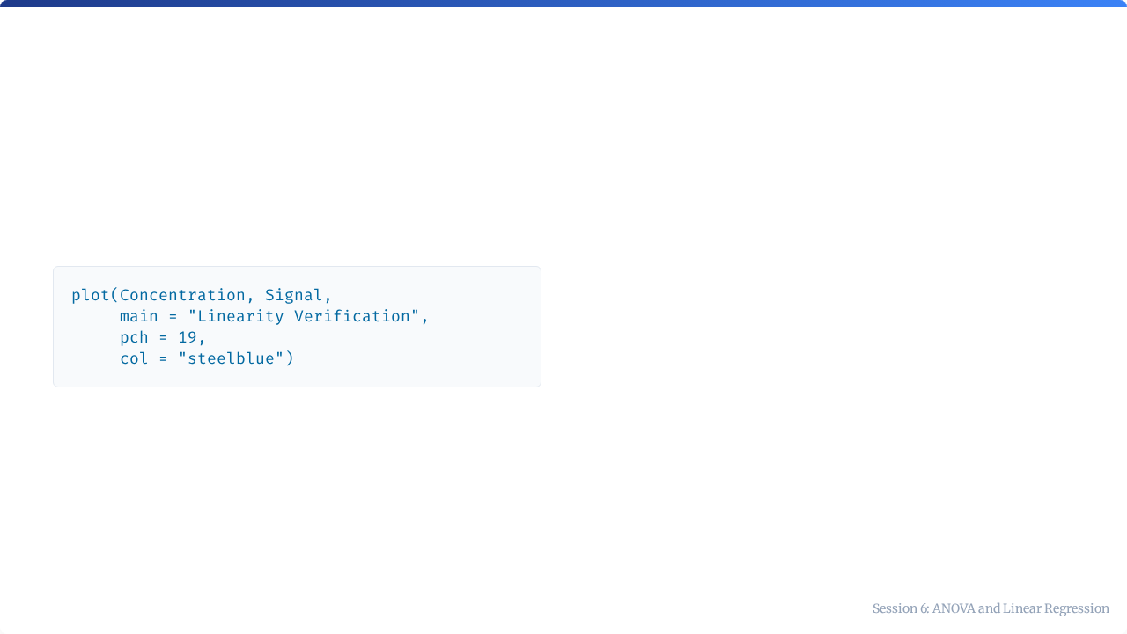
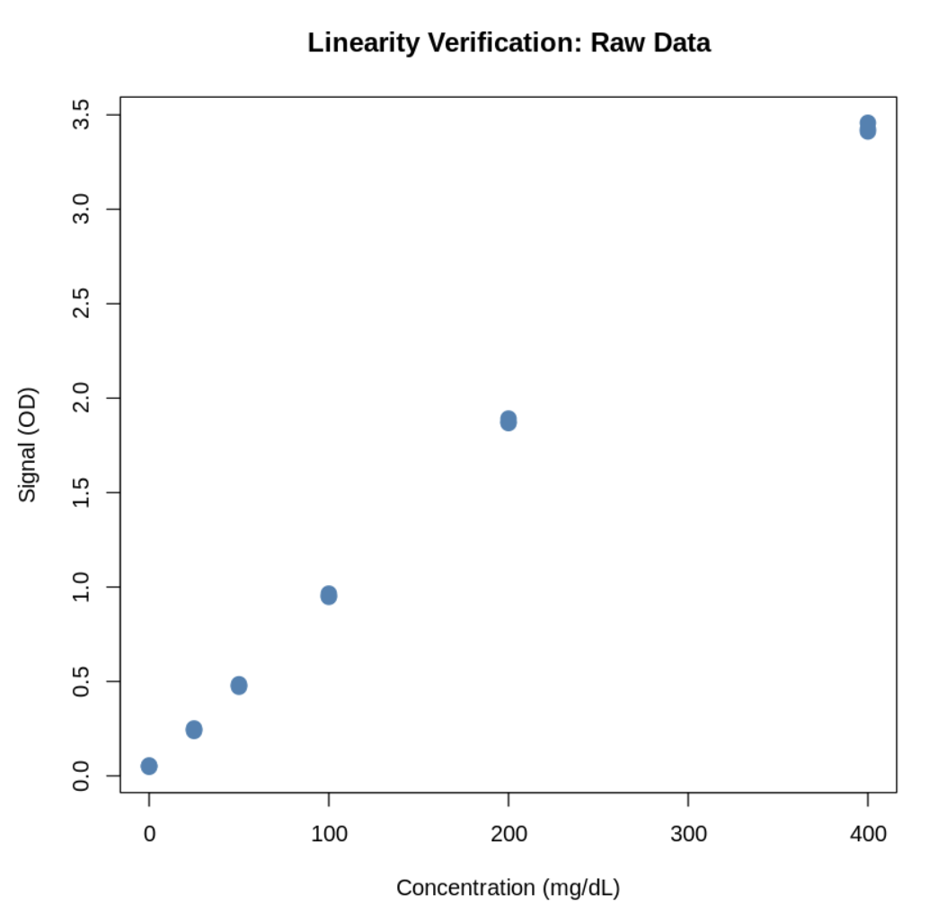
Visualizing Calibration Data
Before fitting a model, always perform a visual check. Does the relationship look linear?

Slide 23
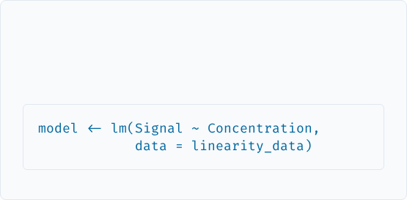
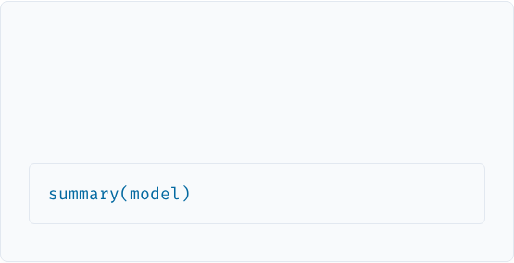
Linear Regression in R
Fitting the Model
Viewing Results
We use the lm() function (linear model).
The summary() function provides coefficients and fit statistics.

Slide 24
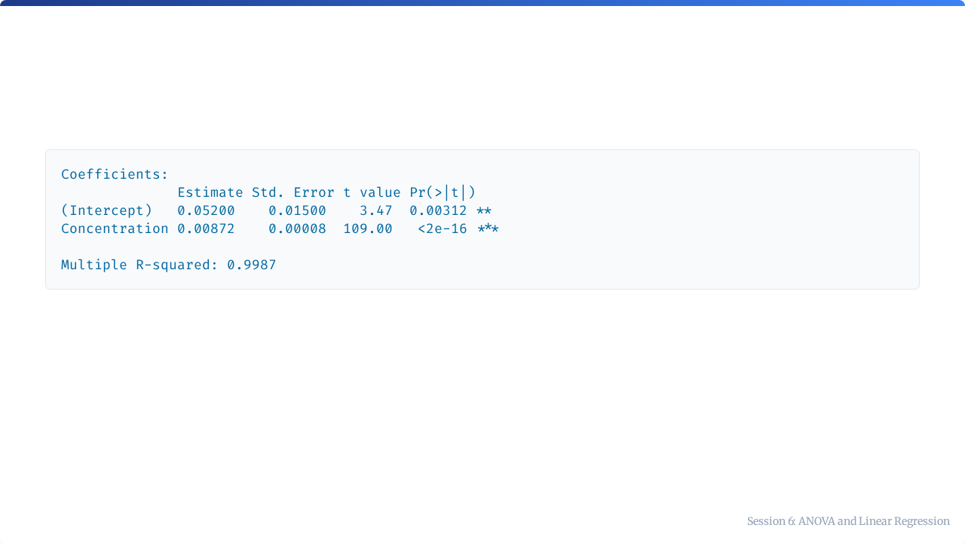
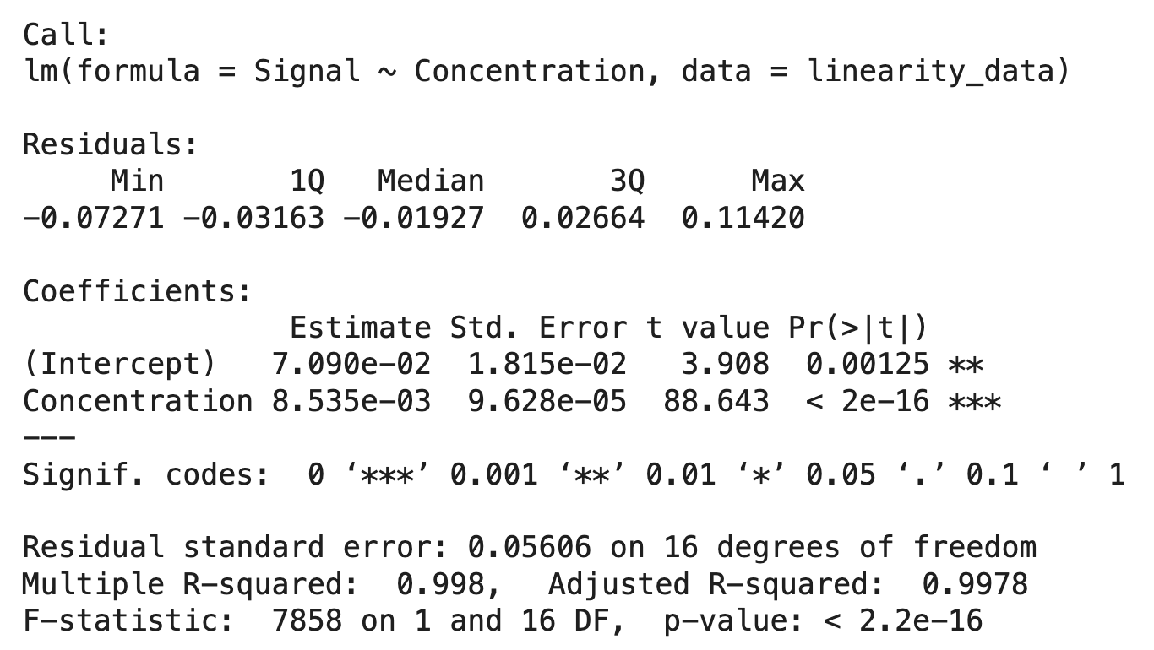
Interpreting lm() Output
Term | Value | Meaning
Intercept | 0.07 | The background signal when concentration is 0.
Slope | 0.008535 | Signal increase per unit of concentration.
R² | 0.998 | 99.8% of the variance is explained by the model.

Slide 25
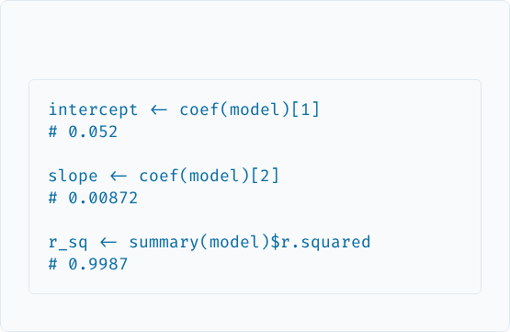

Getting the Equation
R Code
Final Calibration Equation:
Signal = 0.0085 × Concentration + 0.0709

Slide 26
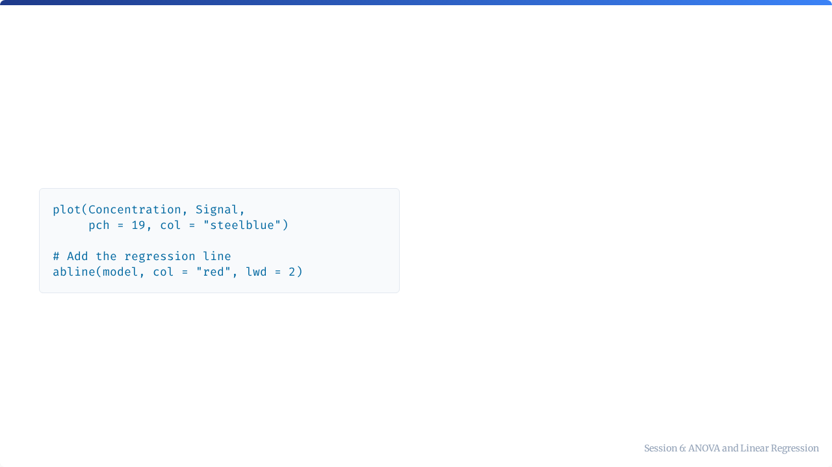
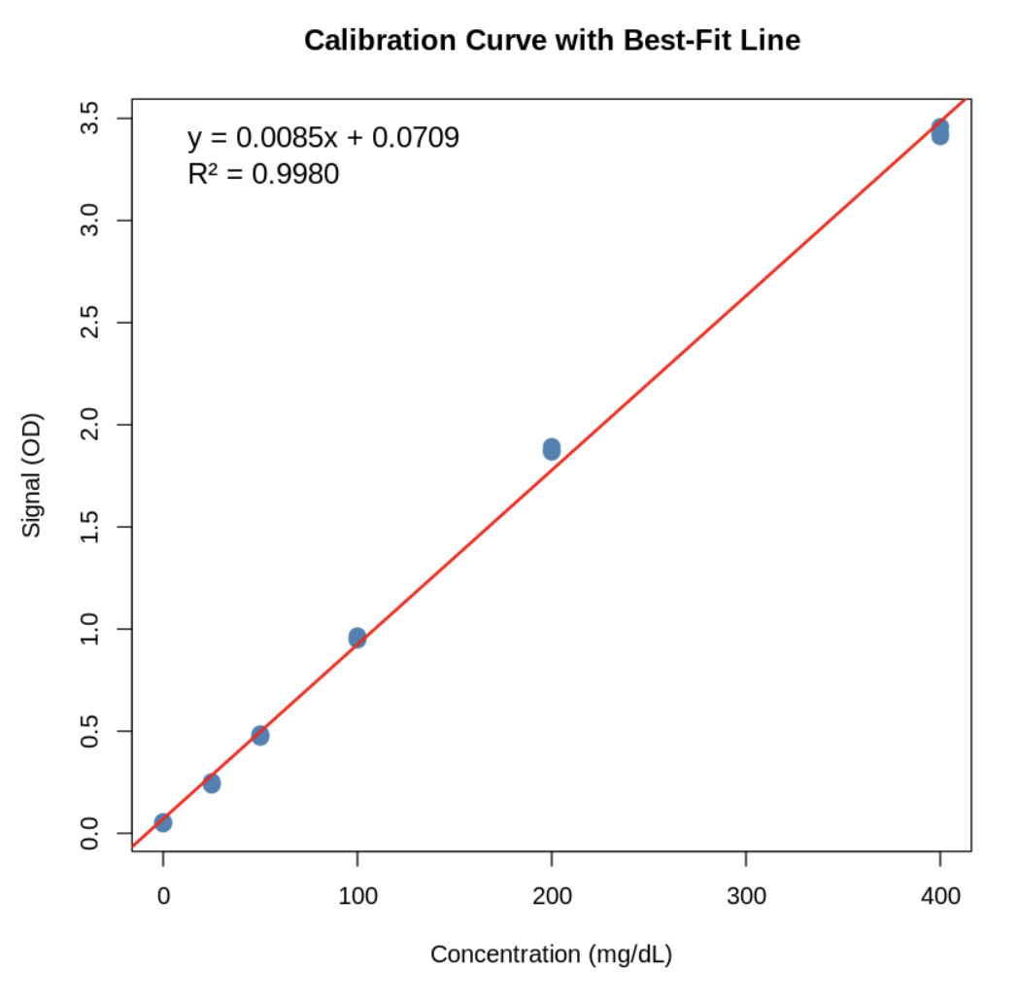
Adding the Regression Line
This visualizes how well our calculated model fits the actual data points.

Slide 27

Understanding R²
Interpretation
R² Value | Meaning
0.99+ | Excellent fit (Standard for Clinical Labs)
0.95–0.99 | Good fit
< 0.90 | Poor fit — Investigate!
Coefficient of Determination

Slide 28
Why Check Residuals?
What to Look For
The Concept
Random Scatter: Good model.
Residual = Observed - Predicted
Curvature: Non-linearity (needs polynomial fit).
Residuals allow us to see patterns that R² might hide.
Funnel Shape: Heteroscedasticity (unequal variance).

Slide 29
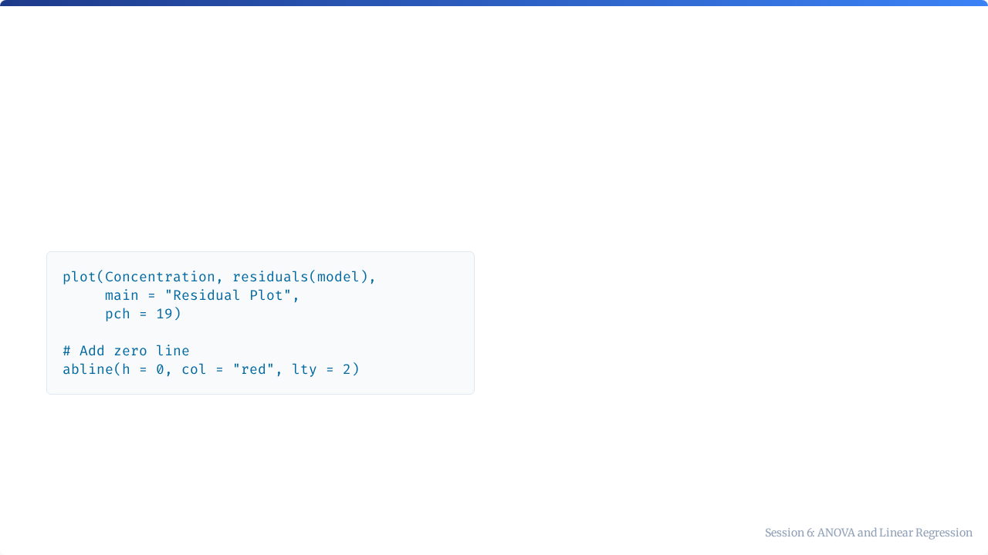
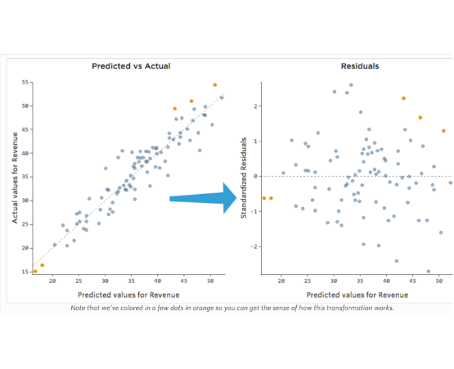
Creating a Residual Plot

Slide 30
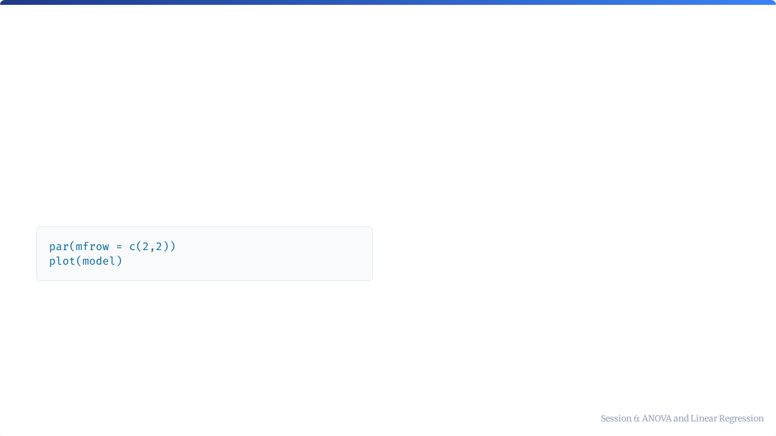
Built-in Diagnostic Plots
What R Generates
Plot | Checks For
Residuals vs Fitted | Linearity
Q-Q Plot | Normality of Residuals
Scale-Location | Homoscedasticity
Residuals vs Leverage | Influential Outliers

Slide 31
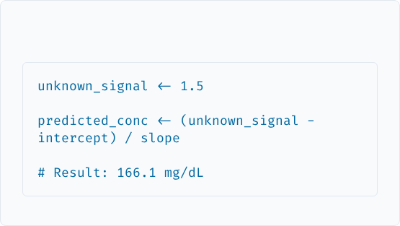


Using the Calibration Curve
R Code

Slide 32
Linearity Acceptance Criteria
Criterion | Typical Requirement
R² | ≥ 0.99
Residuals | Within ±10% of predicted value
Recovery | 95–105% at each concentration level
Note: Specific requirements vary by analyte and method SOP.

Slide 33
Automated Verification Check
if (r_squared >= 0.99) { cat("✅ R² PASS") } else { cat("⚠️ R² FAIL") } if (max(abs(residuals)) <= 0.10 * predicted) { cat("✅ Residuals PASS") } else { cat("⚠️ Residuals FAIL") }

Slide 34
Summary: ANOVA vs. Regression
Feature | ANOVA | Linear Regression
Purpose | Compare group means | Model relationships
Question | "Are groups different?" | "What is the equation?"
R Function | aov() | lm()
Key Statistics | F-value, p-value | R², slope, intercept
Lab Use | Analyzer/Lot Comparison | Calibration Curves

Slide 35



Key Takeaways
ANOVA
Regression
Residuals
Use for comparing 3+ groups. Always follow up with Tukey HSD.
Models y = mx + c. Use R² ≥ 0.99 as a quality standard.
Essential for validating that your model assumptions are met.

Slide 36

Tutorial 6
Calibration Verification in Practice
Open your R environment

Slide 37
Tutorial 6: Calibration Verification
Building and Validating Standard Curves

Slide 38


Your Scenario
The Task
You are performing annual linearity verification following CLSI EP06 guidelines.
The Data
6 Concentration Levels
•
Verify linear response across reportable range.
•
Document calibration equation.
Each measured in triplicate.
•
Ensure R² ≥ 0.99.

Slide 39
What You'll Practice
Step | Skill | Time
1-2 | Load and explore data | 10 min
3 | Fit linear model | 15 min
4 | Create calibration plot | 15 min
5 | Analyze residuals | 15 min
6-7 | Calculate unknowns & Report | 15 min

Slide 40
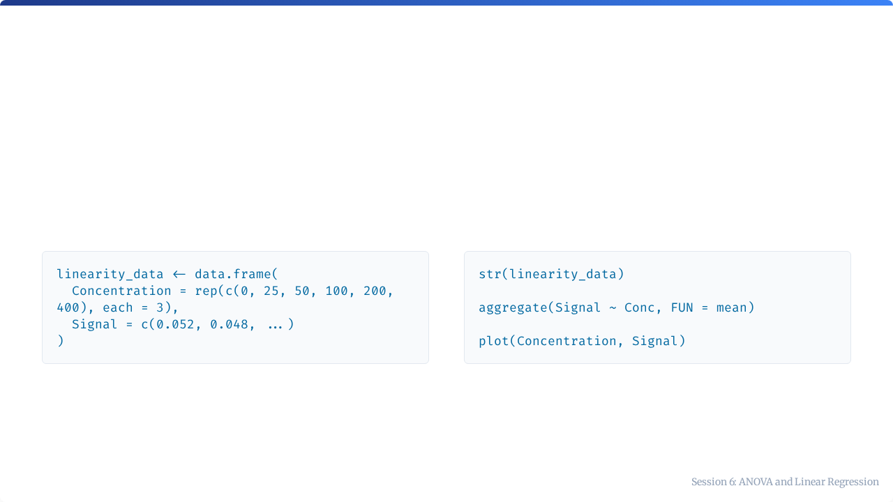
Steps 1-2: Load and Visualize
Load Data
Visualize

Slide 41
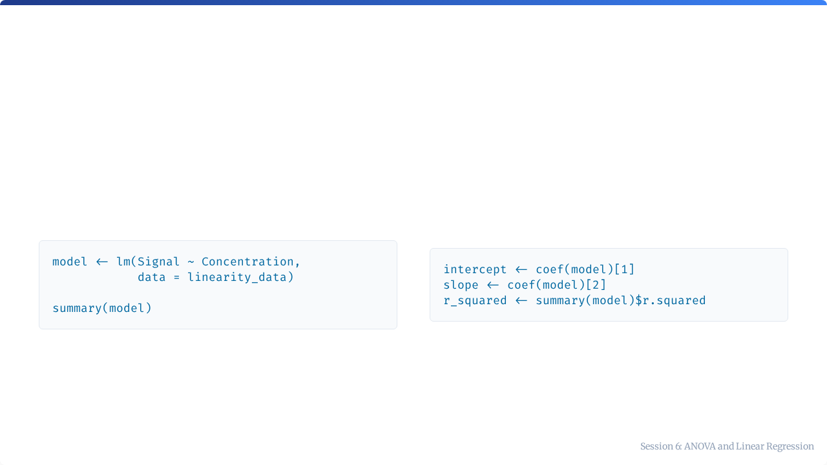
Step 3: Fit Linear Model
The Magic Line
Extract Parameters

Slide 42
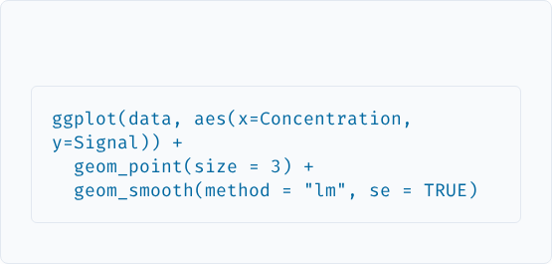
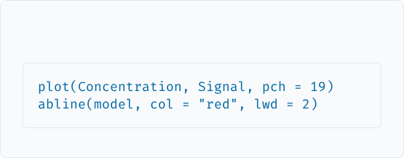
Step 4: Calibration Plot
ggplot2 (Publication Quality)
Base R

Slide 43
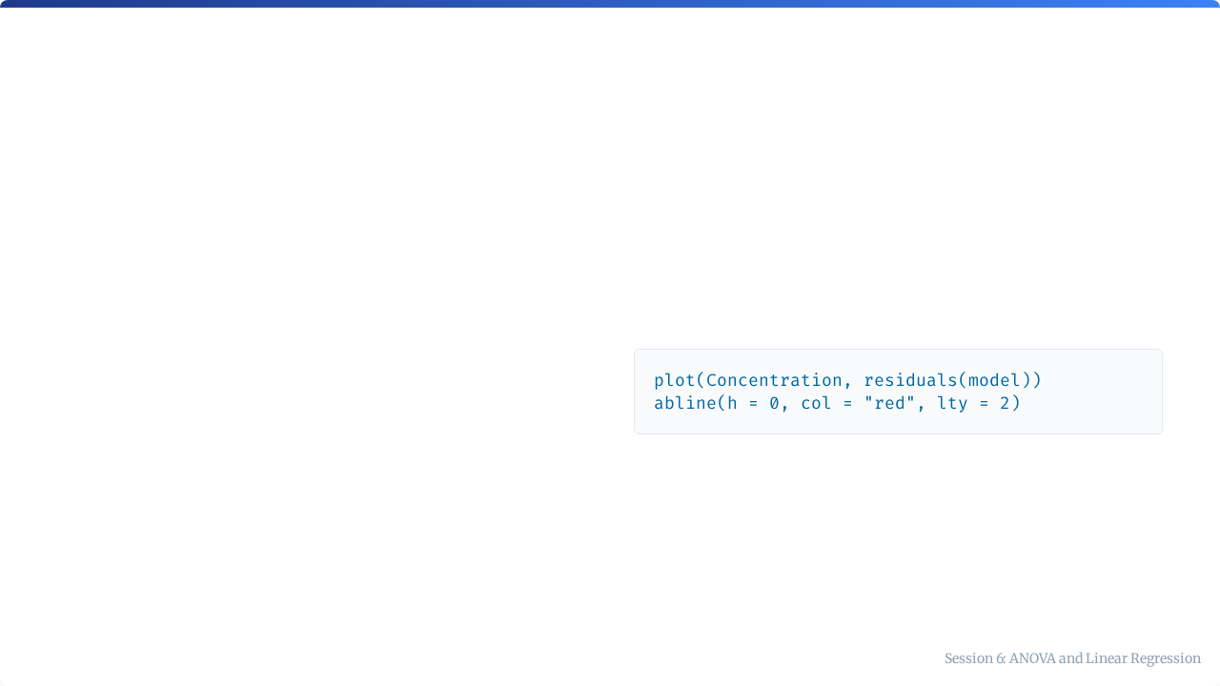
Step 5: Check Residuals
Why?
Code
Residuals reveal problems R² misses:
•
Curvature = Non-linearity
•
Funnel = Unequal variance
Goal: Random scatter around zero.

Slide 44
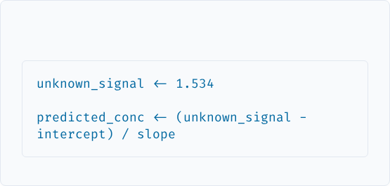

Step 6: Predict Unknowns
Calculation

Slide 45

Step 7: Verification Report
Checklist
Example Conclusion
•
Date and Analyst
"Linearity verification PASSED. R² = 0.9987 exceeds acceptance criterion of 0.99. Assay is acceptable for clinical use."
•
Calibration Equation
•
R² Value (Pass/Fail)
•
Conclusion

Slide 46

Questions?
Session 6 Complete

